Slide 1
Hospital Management System REST API

Slide 2
Technologies use
Node JS
Express JS module
Mongoose db module
Mongo db database
Nodemon module

Slide 3
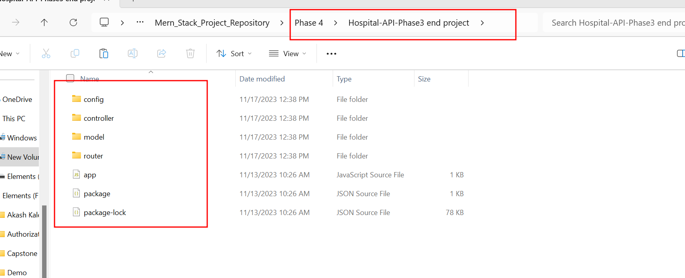
First download the project from git

Slide 4
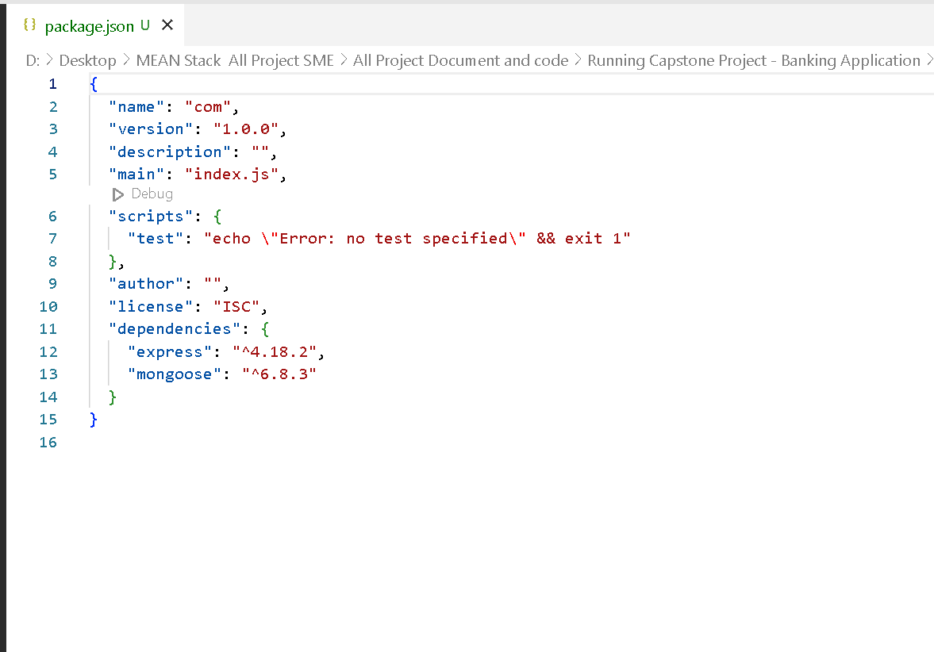
Open the package.json file

Slide 5
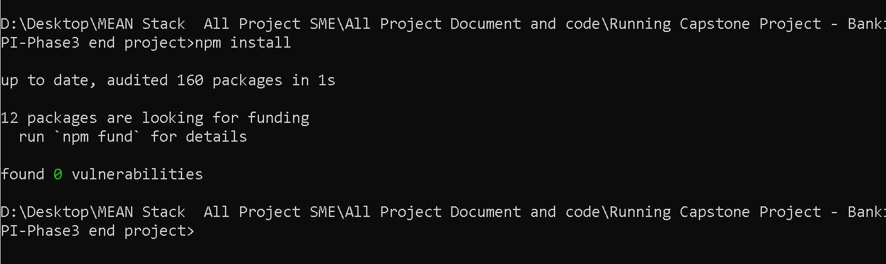
Download required node module using command as
npm install

Slide 6
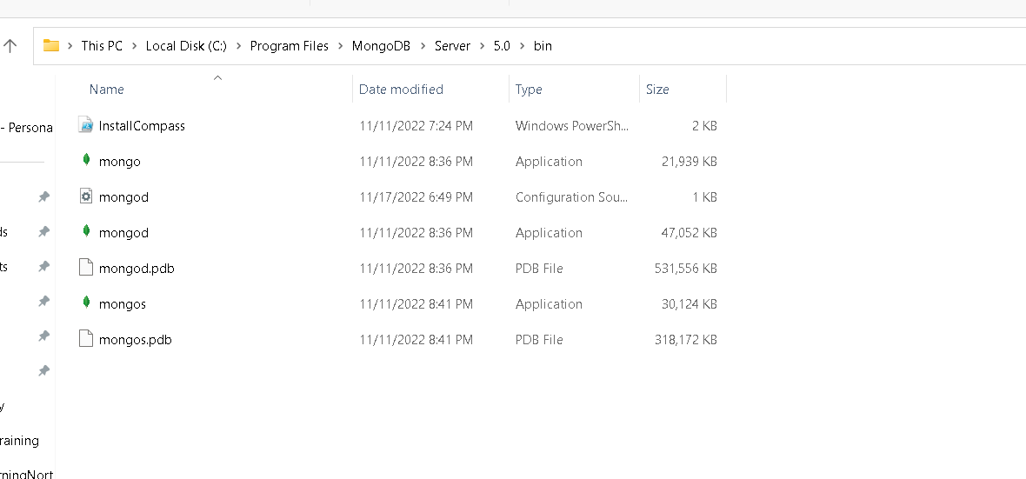
Install mongo db database in your machine

Slide 7
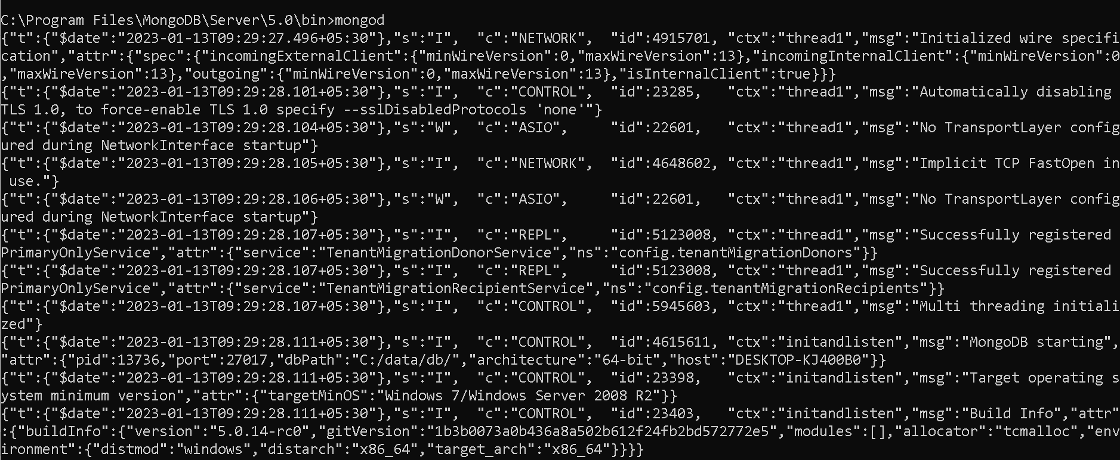
Now start mongo db database
mongod

Slide 8
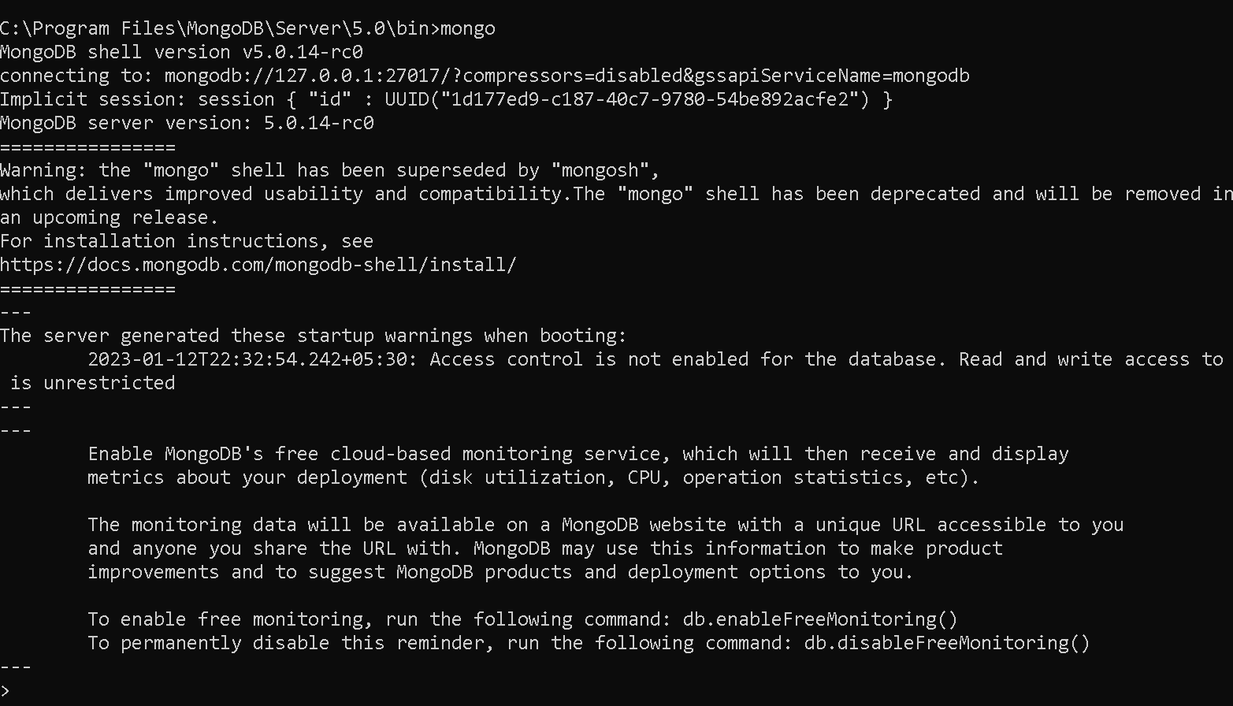
Now open mongo terminal
mongo

Slide 9
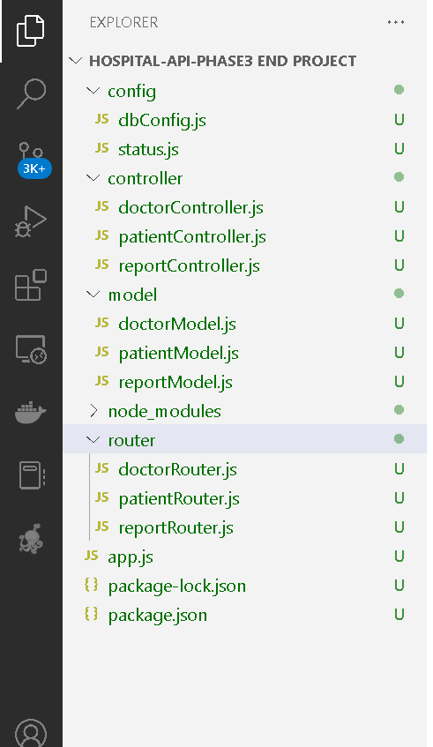
Express js project structure

Slide 10
Folder description
Config : This folder contains dbConfig file which provide the database connection details.
status file provide the dieses details.
Model : This folder contains more than model file which provide the structure for Doctor, Patient and Report collection schema details
Controller : This folder contains more than controller file which contains set of method which help to do the operation on collection using model files. Which takes request from router file do the operation and provide the response to client.
Router : This folder contains more than one file which help to map the sub path and http method base upon the request.
App.js : This file in entry of the application.

Slide 11
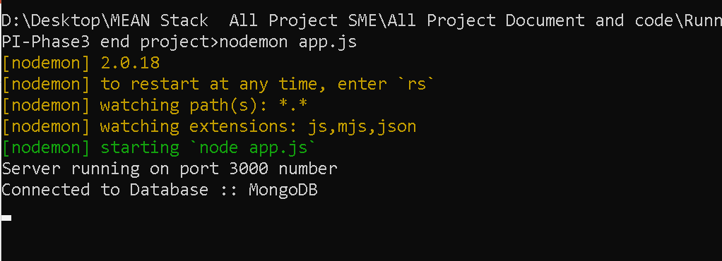
Now run the app.js file using command as
node app.js or nodemon app.js (before running this command install npm install –g nodemon

Slide 12
Now you can check all REST API using
REST client
POST Man tool
Command line client as Git
So we are using Git command prompt with CRL command to verify all rest API.

Slide 13
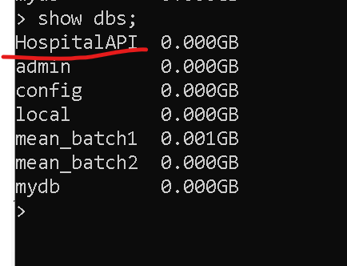
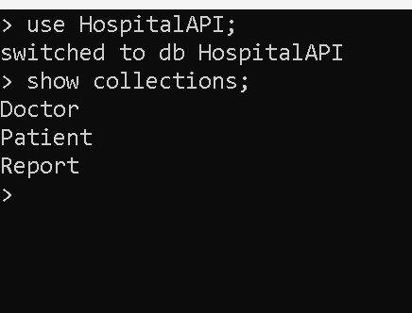
Please verify database created or not in mongo db database
Make sure database must be running

Slide 14
Doctor REST API
Post method : register for doctor details
http://localhost:3000/api/doctor/register
Post method : login for doctor
http://localhost:3000/api/doctor/login
Get method : view all doctors details
http://localhost:3000/api/doctor/viewDoctor
Put method : change doctor password
http://localhost:3000/api/doctor/changePassword

Slide 15
Patient REST API
Post method : register for patient details
http://localhost:3000/api/patient/register
Post method : patient can create the report
http://localhost:3000/api/patient/:id/createReport
Get method : Patient can view its own report
http://localhost:3000/api/patient/:id/viewPatientReports

Slide 16
Report REST API
Get method : fetch report by status
http://localhost:3000/api/report/0
Get method : fetch all reports
http://localhost:3000/api/report/fetchAllReports

Slide 17
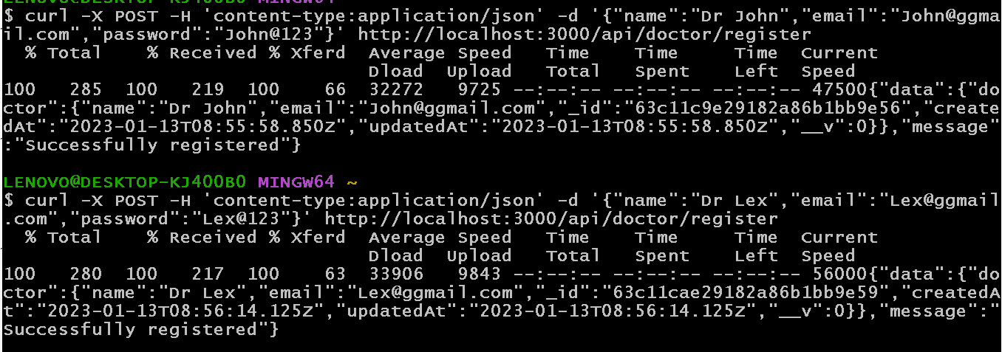
http://localhost:3000/api/doctor/register
curl -X POST -H 'content-type:application/json' -d '{"name":"Dr Steven","email":"Steven@ggmail.com","password":"steven@123"}' http://localhost:3000/api/doctor/register

Slide 18
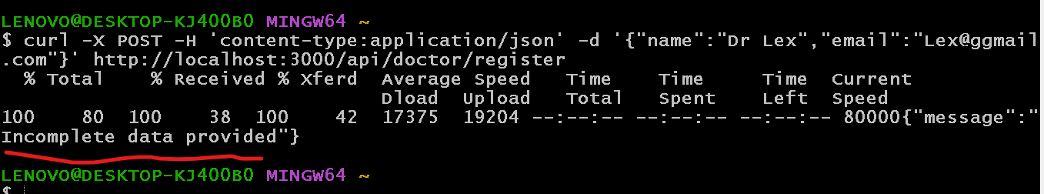
http://localhost:3000/api/doctor/register
curl -X POST -H 'content-type:application/json' -d '{"name":"Dr Steven","email":"Steven@ggmail.com}' http://localhost:3000/api/doctor/register
if we miss some property

Slide 19
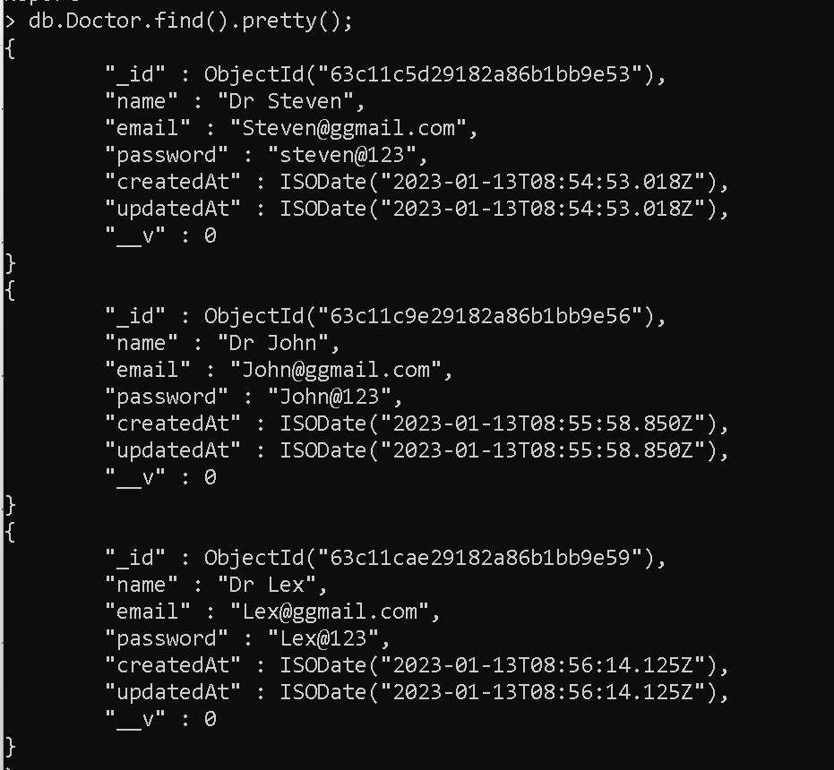
After stored all information view in db

Slide 20
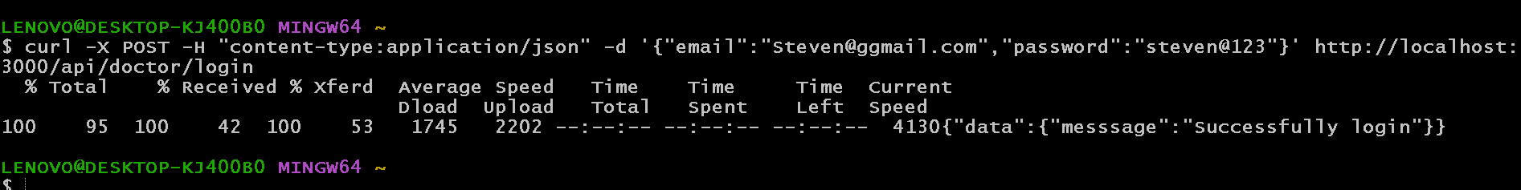
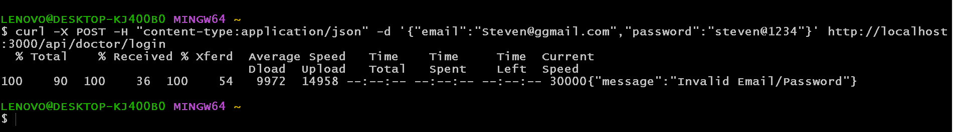
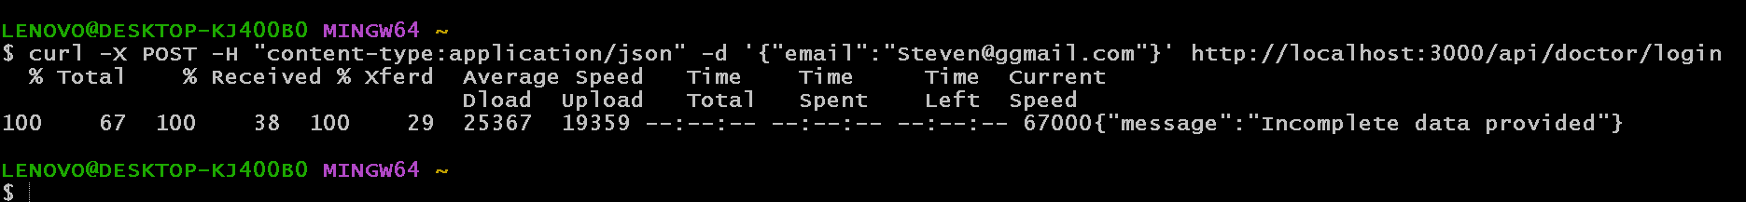
http://localhost:3000/api/doctor/login

Slide 21
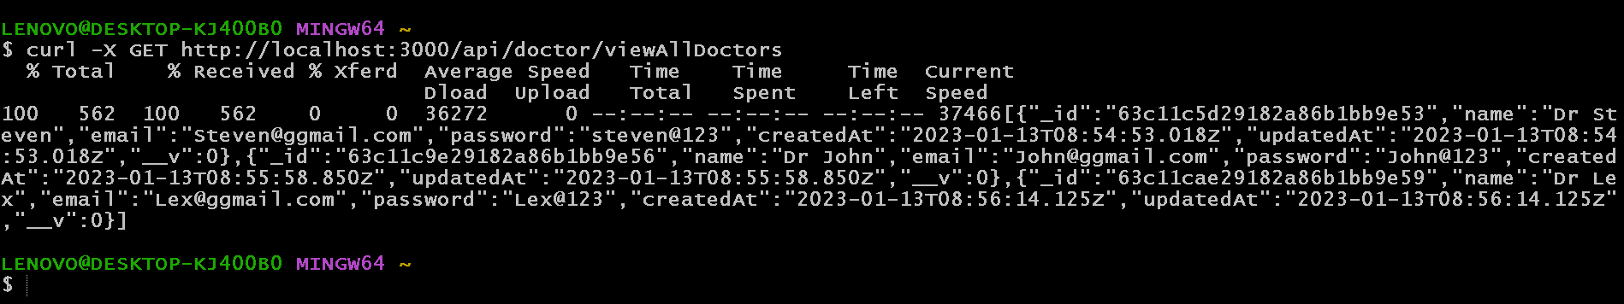
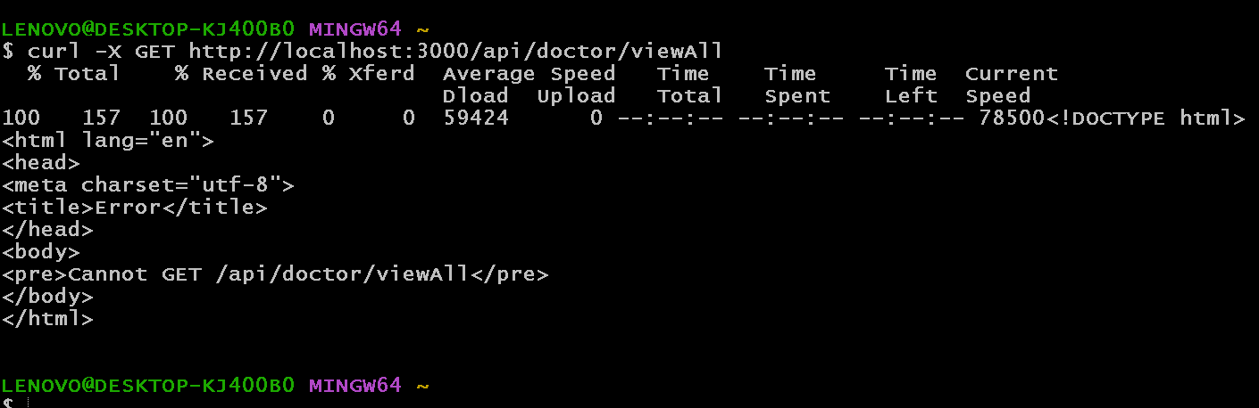
http://localhost:3000/api/doctor/viewAllDoctors

Slide 22
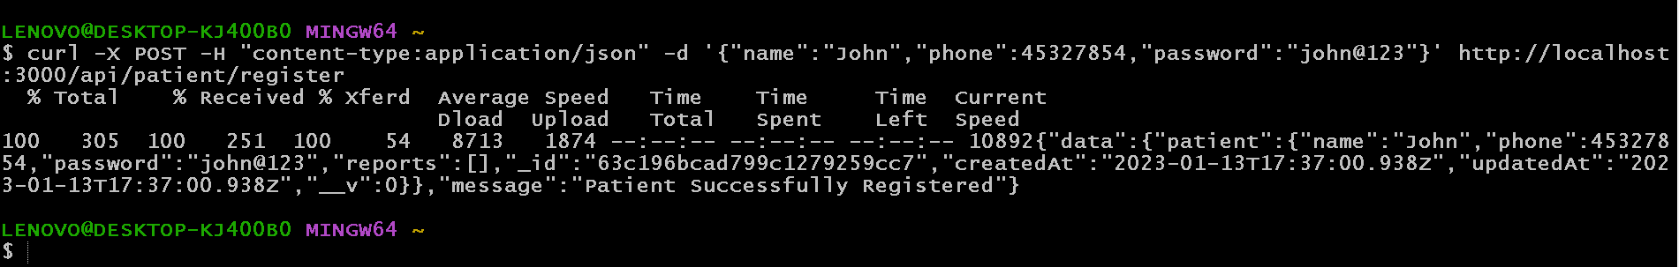
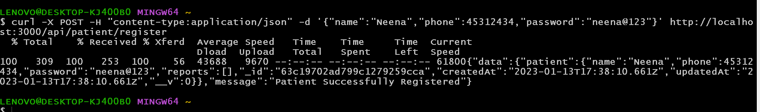
http://localhost:3000/api/patient/register

Slide 23
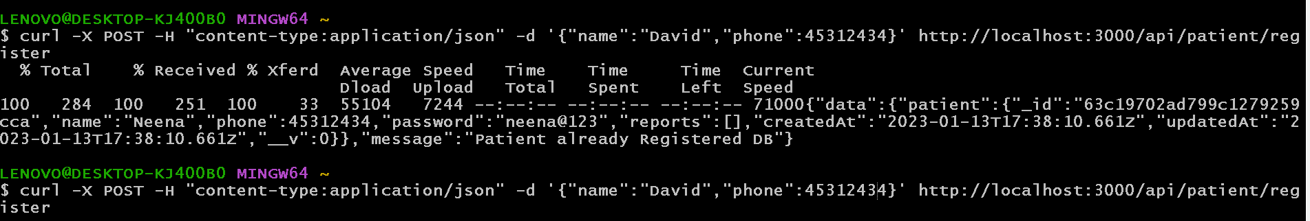
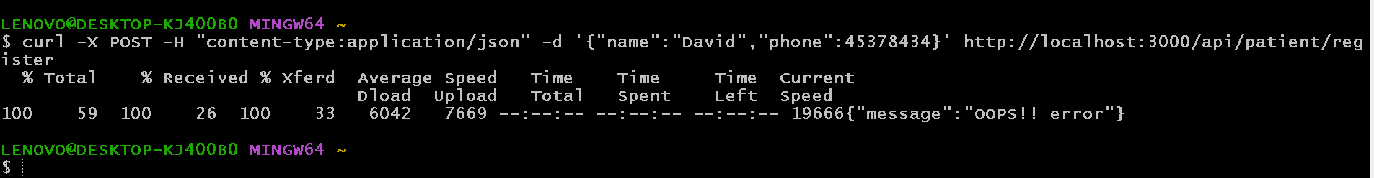
http://localhost:3000/api/patient/register

Slide 24
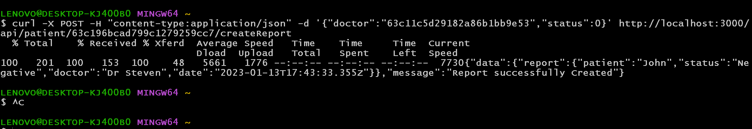
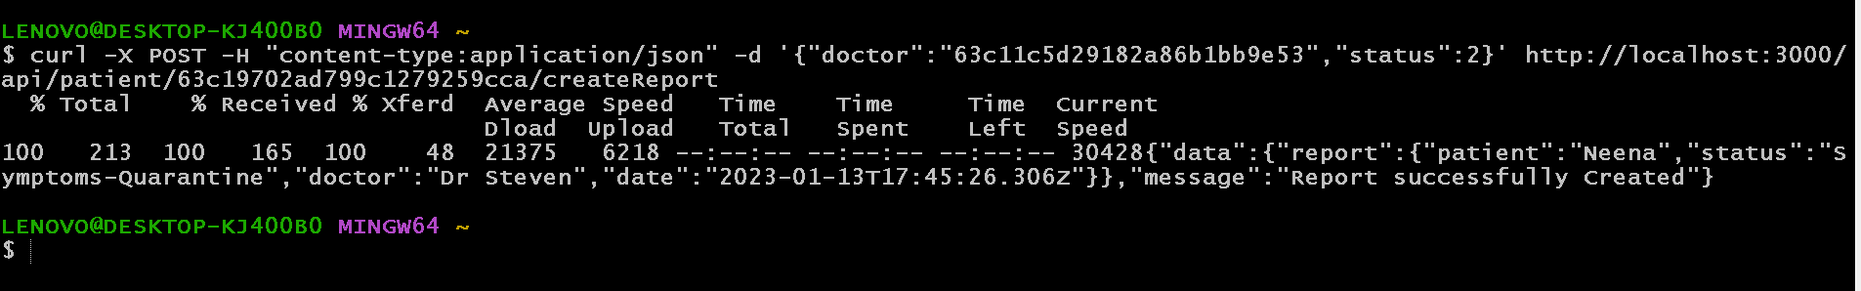
http://localhost:3000/api/patient/id/createReport
We need to pass the patient id, doctor id and status ie present in status.js inside config file

Slide 25
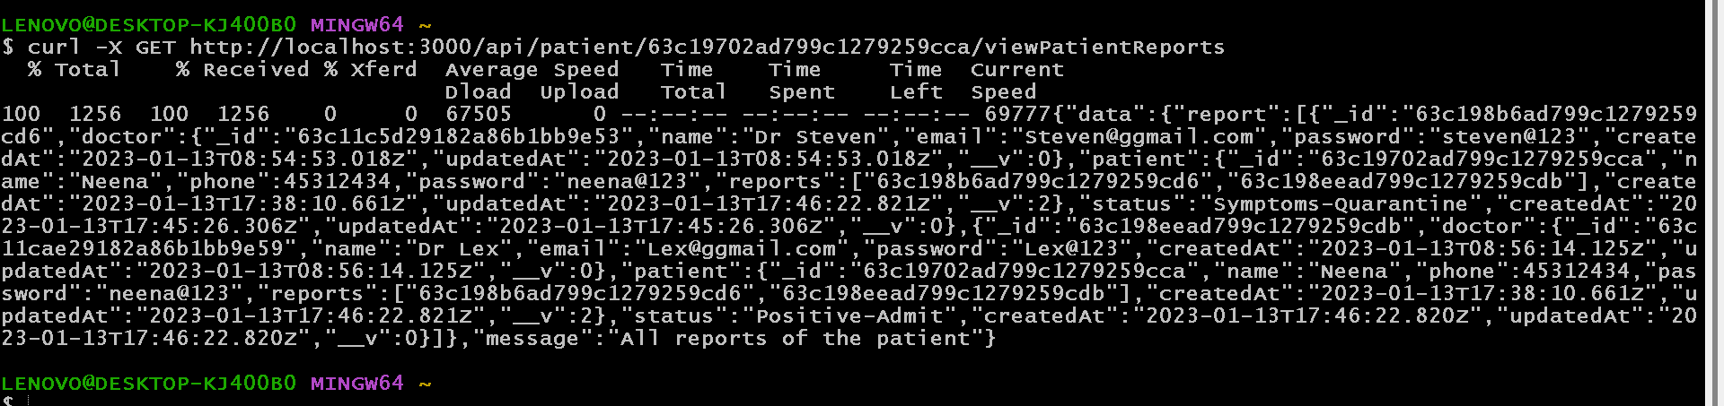
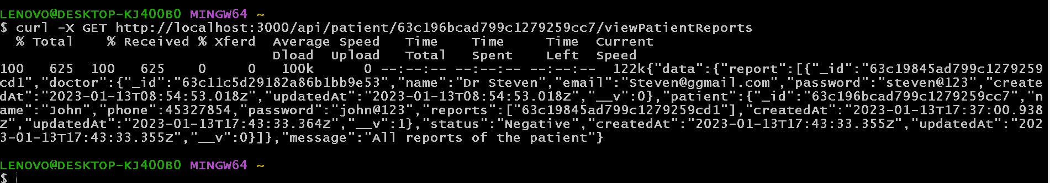
http://localhost:3000/api/patient/id/viewPatientReports

Slide 26
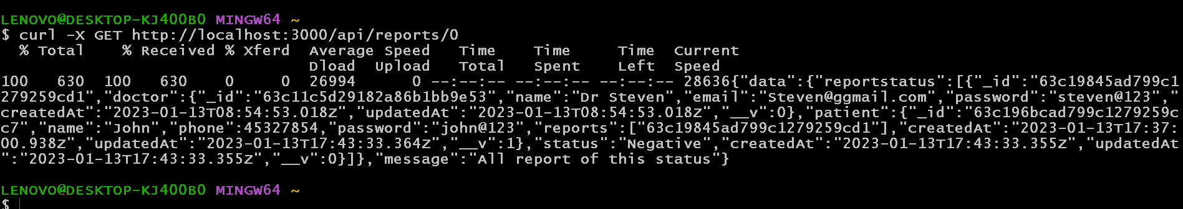
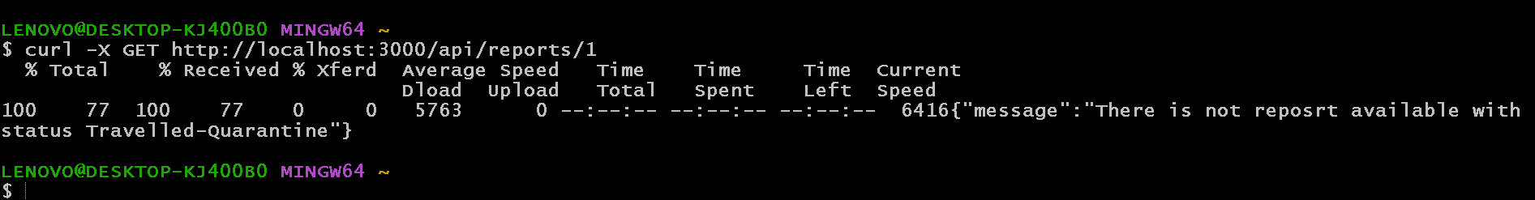
http://localhost:3000/api/reports/0/status

Slide 27
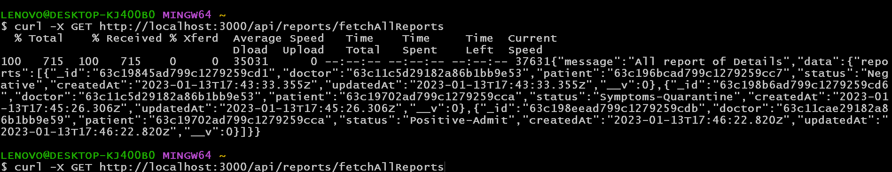
http://localhost:3000/api/reports/fetchAllReports

